Slide 1
Critical Thinking Inc
Yours Truly

Slide 2
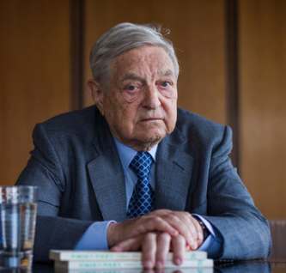
George Soros
Once we realize that imperfect understanding is the human condition, there is no shame in being wrong, only in failing to correct our mistakes.

Slide 3
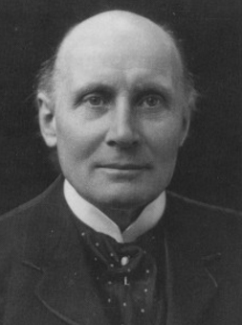
Alfred North Whitehead
Civilization advances by extending the number of important operations which we can perform without thinking of them

Slide 4
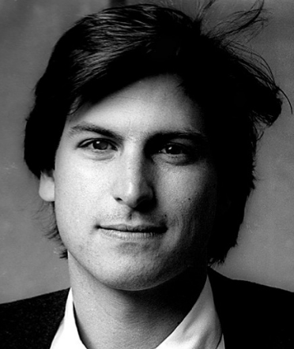
Steve Jobs
Being the richest man in the cemetery doesn't matter to me. Going to bed at night saying ‘We've done something wonderful’, that's what matters to me

Slide 5
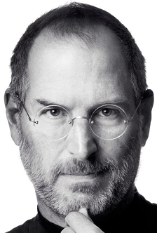
Steve Jobs
Sometimes when you innovate, you make mistakes. It is best to admit them quickly, and get on with improving your other innovations

Slide 6
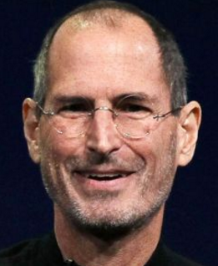
Steve Jobs
People don’t know what they want till you show it to them
Innovation distinguishes between a leader and a follower

Slide 7
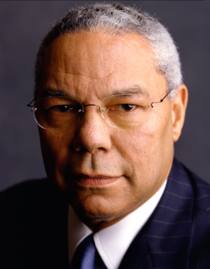
General Colin Powell
Being responsible sometimes means pissing people off
Good leadership involves responsibility to the welfare of the group, which means that some people will get angry at your actions and decisions. It's inevitable - if you're honorable. Trying to get everyone to like you is a sign of mediocrity. You'll avoid the tough decisions, you'll avoid confronting the people who need to be confronted, and you'll avoid offering differential rewards based on differential performance because some people might get upset. Ironically, by procrastinating on the difficult choices, by trying not to get anyone mad, and by treating everyone equally "nicely" regardless of their contributions, you'll simply ensure that the only people you'll wind up angering are the most creative and productive people in the organization.

Slide 8
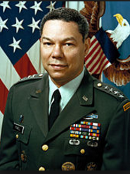
General Colin Powell
The day soldiers stop bringing you their problems is the day you have stopped leading them. They have either lost confidence that you can help them or concluded that you do not care. Either case is a failure of leadership.
If this were a litmus test, the majority of CEOs would fail. One, they build so many barriers to upward communication that the very idea of someone lower in the hierarchy looking up to the leader for help is ludicrous. Two, the corporate culture they foster often defines asking for help as weakness or failure, so people cover up their gaps, and the organization suffers accordingly. Real leaders make themselves accessible and available. They show concern for the efforts and challenges faced by underlings-even, as they demand high standards. Accordingly, they are more likely to create an environment where problem analysis replaces blame.

Slide 9
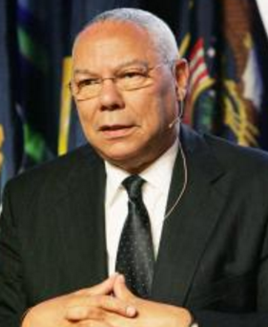
General Colin Powell
Don't be buffaloed by experts. Experts often possess more data than judgment. The Elite can become so inbred that they produce hemophiliacs who bleed to death as soon as they are nicked by the real world.
Small companies and startups don't have the time for analytically detached experts. They don't have the money to subsidize lofty elites, either. The president answers the phone and drives the truck when necessary; everyone on the payroll visibly produces and contributes to bottom-line results or they're history. But as companies get bigger, they often forget who "brought them to the dance" things like all-hands involvement, egalitarianism, informality, market intimacy, daring, risk, speed, agility. Policies that emanate from ivory towers often have an adverse impact on the people out in the field who are fighting the wars or bringing in the revenues. Real leaders are vigilant - and combative - in the face of these trends.

Slide 10
General Colin Powell
Never neglect details. When everyone's mind is dulled or distracted the leader must be doubly vigilant.
Strategy equals execution. All the great ideas and visions in the world are worthless if they can't be implemented rapidly and efficiently. Good leaders delegate and empower others liberally, but they pay attention to details, every day. (Think about supreme athletic coaches like Jimmy Johnson, Pat Riley and Tony La Russa). Bad ones - even those who fancy themselves as progressive visionaries - think they're somehow "above" operational details. Paradoxically, good leaders understand something else: obsessive routine in carrying out the details begets conformity and complacency, which in turn dulls everyone’s mind. That is why even as they pay attention to details, they continually encourage people to challenge the process. They implicitly understand the sentiment of CEO leaders like Quad Graphic's Harry Quadracchi, Oticon's Lars Kolind and the late Bill McGowan of MCI, who all independently asserted that the Job of a leader is not to be the chief organizer, but the chief disorganizer.

Slide 11
General Colin Powell
You don’t know what you can get away with until you try
You know the expression "it's easier to get forgiveness than permission?" Well, it's true. Good leaders don't wait for official blessing to try things out. They're prudent, not reckless. But they also realize a fact of life in most organizations: if you ask enough people for permission, you'll inevitably come up against someone who believes his job is to say "no.“ So the moral is, don't ask. I'm serious. In my own research with colleague Linda Mukai, we found that less effective middle managers endorsed the sentiment, "If I haven't explicitly been told 'yes,' I can't do it," whereas the good ones believed "If I haven't explicitly been told 'no,' I can." There's a world of difference between these two points of view..

Slide 12
General Colin Powell
Perpetual optimism is a force multiplier
The ripple effect of a leader's enthusiasm and optimism is awesome. So is the impact of cynicism and pessimism. Leaders who whine and blame engender those same behaviors among their colleagues. I am not talking about stoically accepting organizational stupidity and performance incompetence with a "what, me worry?" smile. I am talking about a gung ho attitude that says "we can change things here, we can achieve awesome goals, we can be the best." Spare me the grim litany of the "realist;" give me the unrealistic aspirations of the optimist any day.

Slide 13
General Colin Powell
Organization doesn't really accomplish anything. Plans don't accomplish anything, either. Theories of management don't much matter. Endeavors succeed or fail because of the people involved. Only by attracting the best people will you accomplish great deeds
In a brain-based economy, your best assets are people. We've heard this expression so often that it's become trite. But how many leaders really "walk the talk" with this stuff? Too often, people are assumed to be empty chess pieces to be moved around by grand viziers, which may explain why so many top managers immerse their calendar time in deal making, restructuring and the latest management fad. How many immerse themselves in the goal of creating an environment where the best, the brightest, the most creative are attracted, retained and, most importantly, unleashed?

Slide 14
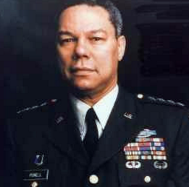
General Colin Powell
Powell's Rules for Picking People: Look for intelligence and judgment and, most critically, a capacity to anticipate, to see around corners. Also look for loyalty, integrity, a high energy drive, a balanced ego and the drive to get things done.
How often do our recruitment and hiring processes tap into these attributes? More often than not, we ignore them in favor of length of resume, degrees and prior titles. A string of job descriptions a recruit held yesterday seem to be more important than who one is today, what they can contribute tomorrow or how well his values mesh with those of the organization. You can train a bright, willing novice in the fundamentals of your business fairly readily, but it's a lot harder to train someone to have integrity, judgment, energy, balance and the drive to get things done. Good leaders stack the deck in their favor right in the recruitment phase.

Slide 15
General Colin Powell
Great leaders are almost always great simplifiers, who can cut through argument, debate and doubt, to offer a solution everybody can understand
Effective leaders understand the KISS principle, or Keep It Simple, Stupid. They articulate vivid, overarching goals and values, which they use to drive daily behaviors and choices among competing alternatives. Their visions and priorities are lean and compelling, not cluttered and buzzword-laden. Their decisions are crisp and clear, not tentative and ambiguous. They convey an unwavering firmness and consistency in their actions, aligned with the picture of the future they paint. The result? Clarity of purpose, credibility of leadership, and integrity in organization.

Slide 16
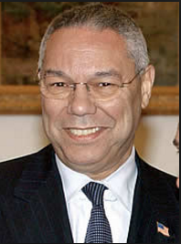
General Colin Powell
Have fun in your command. Don't always run at a breakneck pace. Take leave when you've earned it. Spend time with your families."
Corollary: Surround yourself with people who take their work seriously, but not themselves, those who work hard and play hard.
Herb Kelleher of Southwest Air and Anita Roddick of The Body Shop would agree. Seek people who have some balance in their lives, who are fun to hang out with, who like to laugh (at themselves, too) and who have some non-job priorities which they approach with the same passion that they do their work. Spare me the grim workaholic or the pompous pretentious "professional;" I'll help them find jobs with my competitor.

Slide 17
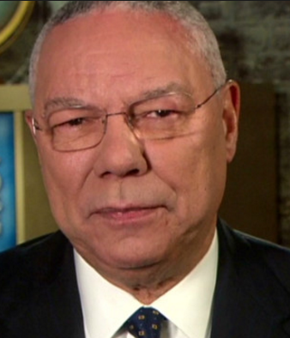
General Colin Powell
Command is lonely
Harry Truman was right. Whether you're a CEO or the temporary head of a project team, the buck stops here. You can encourage participative management and bottom-up employee involvement but ultimately, the essence of leadership is the willingness to make the tough, unambiguous choices that will have an impact on the fate of the organization. I've seen too many non-leaders flinch from this responsibility. Even as you create an informal, open, collaborative corporate culture, prepare to be lonely.

Slide 18
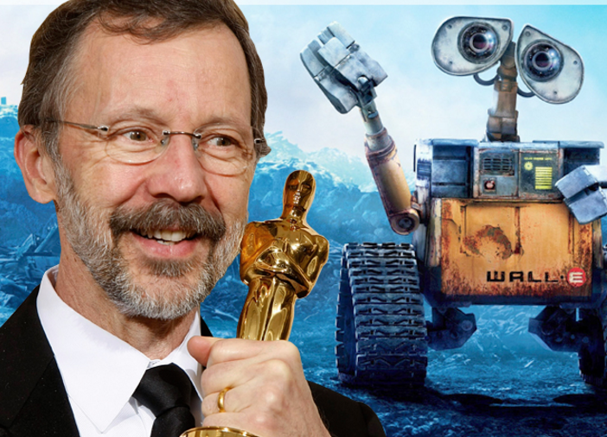
Ed Catmull
If there is more truth in hallway conversations than in meetings, you lose

Slide 19
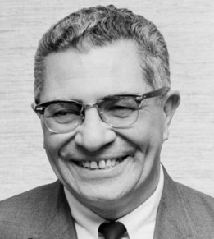
Vince Lombardi
Winning is not a sometime thing, it is an all the time thing. You don’t do things right once in a while… you do them right all the time.

Slide 20
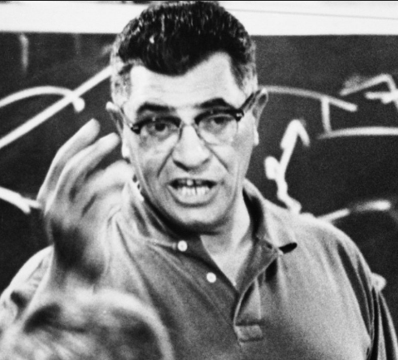
Vince Lombardi
Individual commitment to a group effort – that is what makes a team work, a company work, a society work, a civilization work.

Slide 21
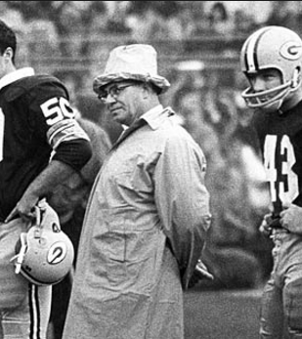
Vince Lombardi
Success is based upon a spiritual quality, a power to inspire others
There is no substitute for hard work

Slide 22
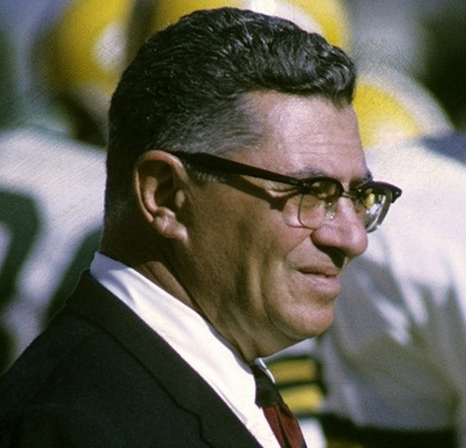
Vince Lombardi
Mental toughness is many things that are rather difficult to explain. Its qualities are sacrifice and self-denial. Also, most importantly, it is combined with a perfectly disciplined will that refuses to give in. It’s a state of mind – you could call it character in action

Slide 23
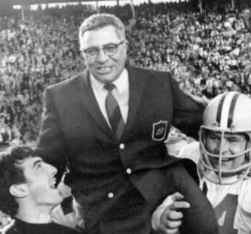
Vince Lombardi
Some guys play with their heads. That’s O.K. You’ve got to be smart to be number one in any business. But, more importantly, you’ve got to play with your heart, with every fiber of your body. If you’re lucky enough to find a guy with a lot of head and lot of heart, he’s never going to come off the field second

Slide 24
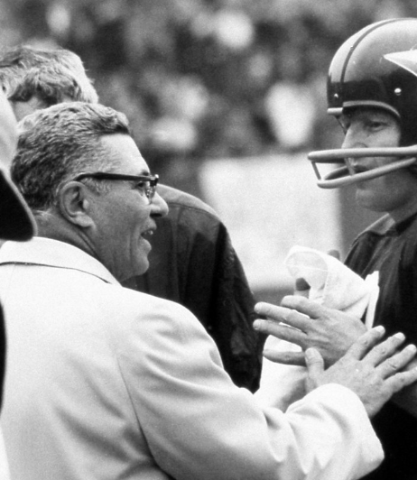
Vince Lombardi
Obstacles are what you see when you take your eyes off the goal

Slide 25
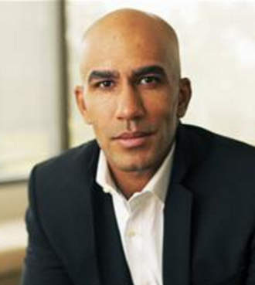
Bill Perkins
This is what we do. If you’re a boxer, you’re going to get punched. You might not get knocked out, but you’re going to get knocked down for sure. We are paid by our investors to get in the ring and mix it up every day
Legendary natural gas trader and hedge fund manager

Slide 26
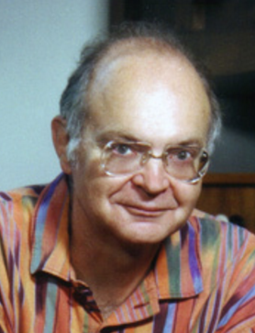
Donald Knuth
If you optimize everything, you will always be unhappy
Premature optimization is the root of all evil

Slide 27
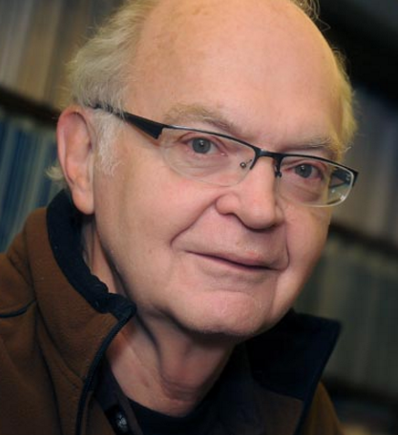
Donald Knuth
Let us change our traditional attitude to the construction of programs. Instead of imagining that our main task is to instruct a computer what to do, let us concentrate rather on explaining to human beings what we want a computer to do

Slide 28
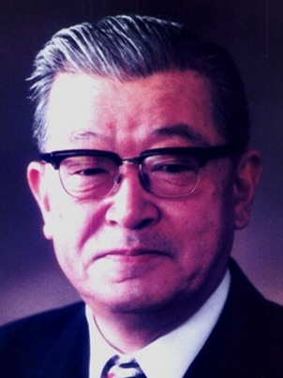
Kaoru Ishikawa
As with many other things, there is a surprising amount of prejudice against quality control, but the proof of the pudding is still in the eating.

Slide 29
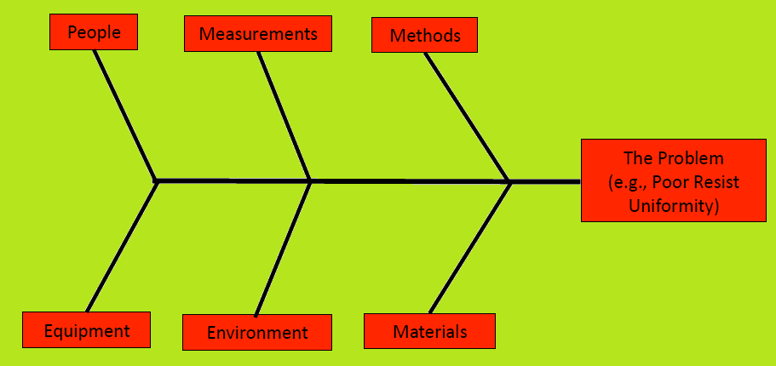
Kaoru Ishikawa
-

Slide 30
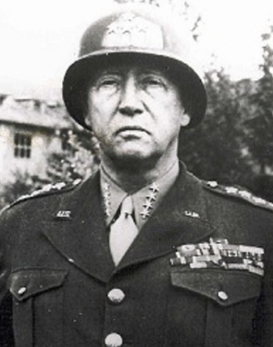
General George Patton
If everyone is thinking alike, then someone isn’t thinking.
A good plan violently executed now is better than a perfect plan executed next week.

Slide 31
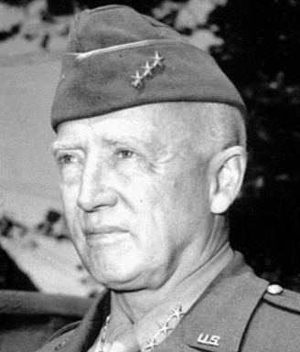
General George Patton
Never tell people how to do things. Tell them what to do and they will surprise you with their ingenuity.

Slide 32
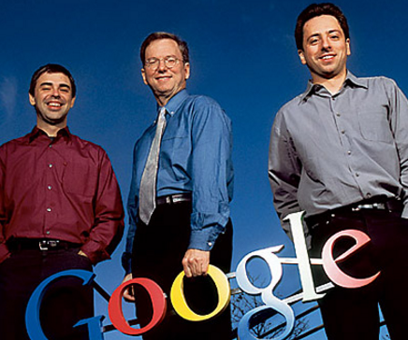
Google Hiring Checklist
General cognitive ability
Role related knowledge
Leadership experience
+
Googleyness :
Ambition and Drive
Team Orientation
Service Orientation
Listening and Communication skills
Bias to Action
Effectiveness
Interpersonal Skills
Creativity and Integrity

Slide 33

Jack Welch
Leaders relentlessly upgrade their team using every encounter to evaluate, coach, and build self-confidence

Slide 34
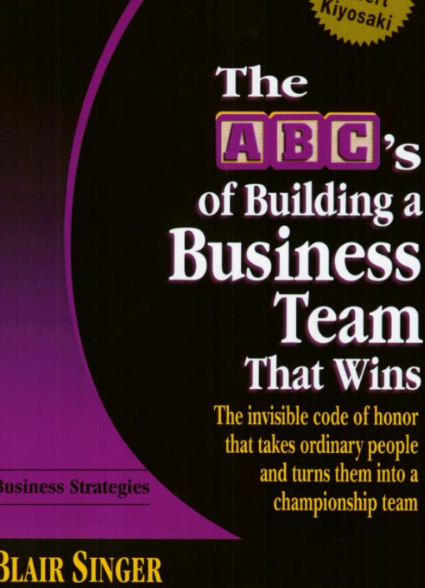
Required Reading
In the absence of rules, people make up their own
Establish a code of honor

Slide 35
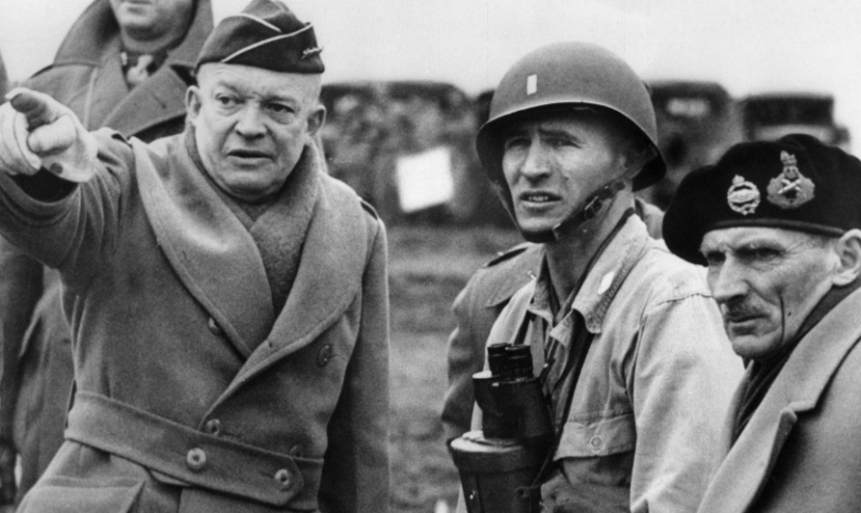
General Dwight D. Eisenhower
In preparing for battle, I have always found that plans are useless, but planning is indispensable

Slide 36
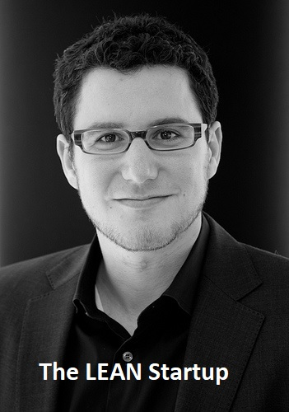
Eric Ries
A startup is a human institution designed to create a new product or service under conditions of extreme uncertainty

Slide 37
Eric Ries
I believe a company’s only sustainable path to long-term economic growth is to build an “innovation factory” that uses Lean Startup techniques to create disruptive innovations on a continuous basis

Slide 38
Eric Ries
Lean Startup Principles
Entrepreneurs are everywhere
Entrepreneurship is management
Validated Learning
Build — Measure — Learn
Innovation Accounting

Slide 39
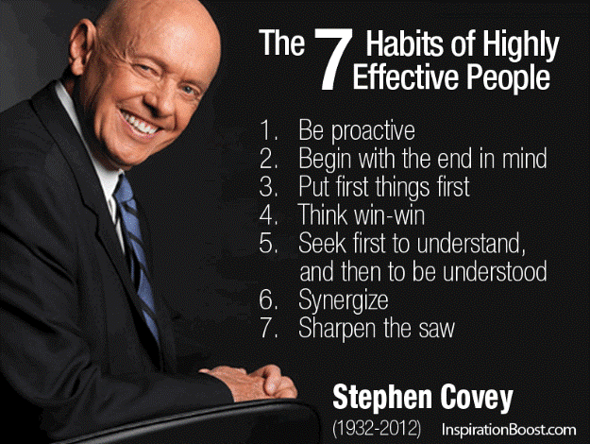
Stephen Covey
Self-management is hard

Slide 40
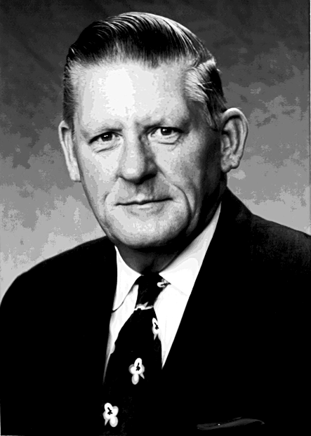
Larry Bossidy
Building blocks of execution :
Know your people and your business
Insist on realism
Set clear goals and priorities
Follow through
Reward the doers
Expand people’s capabilities
Know yourself

Slide 41
Larry Bossidy
The 80-hour week is actually a weakness
In performance reviews, I've had to tell some very smart 80-hour-a-week people that they need to change their work habits, and that the eighty-hour week is actually a major weakness. People like this usually force their direct reports to be in the office or the plant with them on Saturdays, Sundays and holidays. They run them ragged and drain the energy of everyone around them. I'll tell them, "You have to come in here less, but your performance can't change - it must be just as good as it is now. Learn how to get things done through others. Because, if you can't get things done through others, ultimately you're going to sink or burn out." If they promote others on the basis of very long hours worked - which they will, because that is what impresses them - those people will have the same problem.

Slide 42
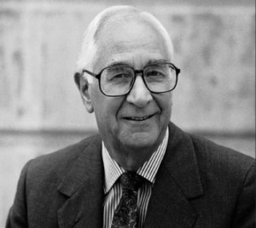
Max de Pree
Intercept entropy by recognizing the signs :
A tendency toward superficiality
A dark tension among key people
No longer having time for celebration and ritual
A growing feeling that rewards and goals are the same thing
When people stop telling tribal stories or can no longer understand them

Slide 43
Max de Pree
Intercept entropy by recognizing the signs :
A recurring effort by some people to convince others that business is, after all, quite simple (The acceptance of complexity and ambiguity and the ability to deal with them constructively are essential
When people begin to have different understandings of words like “responsibility” or “service” or “trust

Slide 44
Max de Pree
Intercept entropy by recognizing the signs :
When problem-makers outnumber problem-solvers
When folks confuse heroes and celebrities
Leaders who seek to control rather than liberate
Manuals

Slide 45
Max de Pree
Intercept entropy by recognizing the signs :
When the pressures of day-to-day operations push aside any concern for vision and risk (I think you know that vision and risk can never be separated)
An orientation toward the dry rules of business school rather than a value orientation that takes into account such things as contribution, spirit, excellence, beauty and joy

Slide 46
Max de Pree
Intercept entropy by recognizing the signs :
When people speak of customers as impositions on their time rather than as opportunities to serve
A growing urge to quantify both history and one’s thoughts about the future (You may be familiar with people who take a look at a prototype and say, “In 1990 we’ll sell $6,493,000 worth” – nothing is more devastating because then you plan either to make that happen or to avoid it)

Slide 47
Max de Pree
Intercept entropy by recognizing the signs :
The urge to establish ratios
Leaders who rely on structures instead of people
A loss of confidence in judgement, experience and people
A loss of grace and style and civility
A loss of respect for the English language

Slide 48

Lori Greiner
People will forget what you said. They will forget what you did. But they will never forget how you made them feel
(Quoting her grandfather)

Slide 49
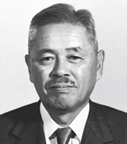
Taiichi Ohno (Toyota)
The Seven Wastes
1. Delay, waiting or time spent in a queue with no value being added 2. Producing more than you need 3. Over processing or undertaking non-value added activity 4. Transportation 5. Unnecessary movement or motion 6. Inventory 7. Reduction of Defects

Slide 50
Taiichi Ohno (Toyota)
The Ten Precepts to think and act to win:
You are a cost. First reduce waste.
First say, "I can do it." And try before everything.
The workplace is a teacher. You can find answers only in the workplace.
Do anything immediately. Starting something right now is the only way to win.
Once you start something, persevere with it. Do not give up until you finish it.
Explain difficult things in an easy-to-understand manner. Repeat things that are easy to understand.
Waste is hidden. Do not hide it. Make problems visible.
Valueless motions are equal to shortening one's life.
Re-improve what was improved for further improvement.
Wisdom is given equally to everybody. The point is whether one can exercise it.

Slide 51
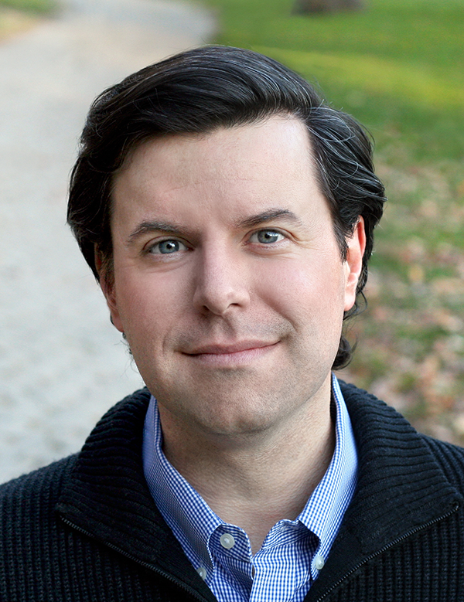
Charles Duhigg
Manage the how, not the who of teams. Psychological safety emerges when everyone feels like they can speak in roughly equal measure and when they are sensitive to how each other feel

Slide 52
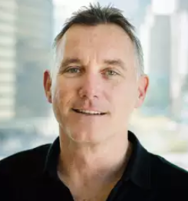
Scott Maxwell (OpenView)
Figuring out what you want to do is easy. The hard part is figuring out what you can do.

Slide 53

Navy SEALs
You never rise to the occasion. You sink to the level of your training
Navy SEAL maxim

Slide 54
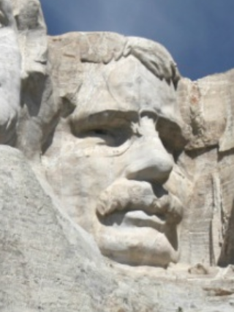
Theodore Roosevelt
It is not the critic who counts; not the man who points out how the strong man stumbles, or where the doer of deeds could have done them better. The credit belongs to the man who is actually in the arena, whose face is marred by dust and sweat and blood; who strives valiantly; who errs, who comes short again and again, because there is no effort without error and shortcoming; but who does actually strive to do the deeds; who knows great enthusiasms, the great devotions; who spends himself in a worthy cause; who at the best knows in the end the triumph of high achievement, and who at the worst, if he fails, at least fails while daring greatly, so that his place shall never be with those cold and timid souls who neither know victory nor defeat.

Slide 55
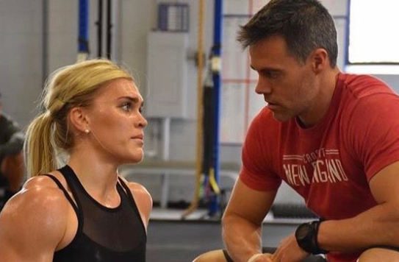
Ben Bergeron
The way I build an athlete is from the inside out. I have no idea if this is the right approach, but it’s the way I do it. It starts with character first, and there are four traits in particular I look for when deciding to take on a new athlete - coachability, confidence, positivity and passion. From the beginning, Katrin has embodied these qualities better than any athlete I’ve worked with

Slide 56
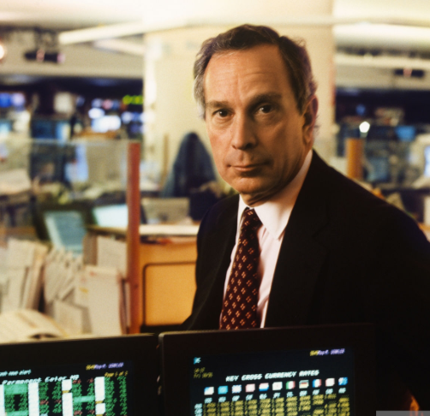
Mike Bloomberg
"Years ago we ran a testimonial ad in Institutional Investor featuring quotes from some of our customers. My favorite came from the guy who said "I have yet to
find an error in the MARKETMASTER data, but when I do, I'll know it's an honest
error, unlike the data I get from Salomon or First Boston."

Slide 57
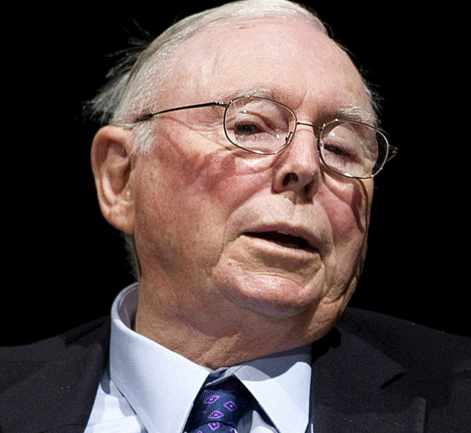
Charlie Munger
If you don't get this elementary, but mildly unnatural, mathematics of elementary probability into your repertoire, then you go through a long life like a one-legged man in an ass-kicking contest. You're giving a huge advantage to everybody else.

Slide 58
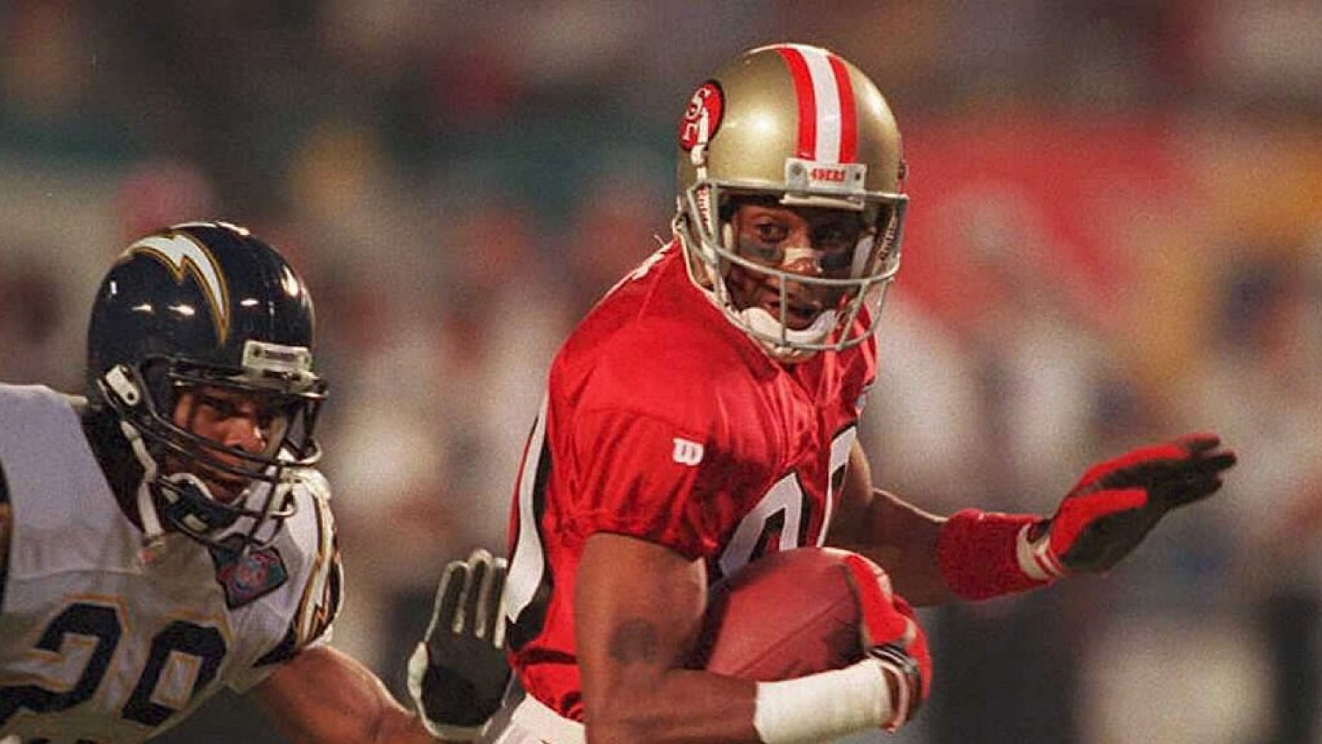
Jerry Rice (49ers)
Today I will do what others won’t so that tomorrow I can do what others can’t

Slide 59
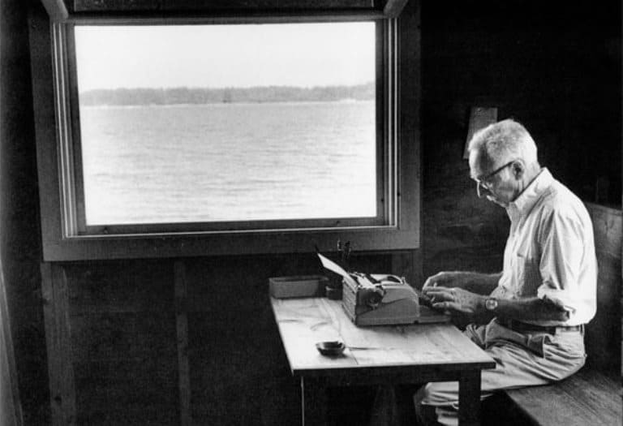
William Zinsser : On Writing Well
Clarity
Brevity
Simplicity
Humanity
Photo of E. B. White credit Jill Krementz (also wife of K. Vonnegut)

Slide 60
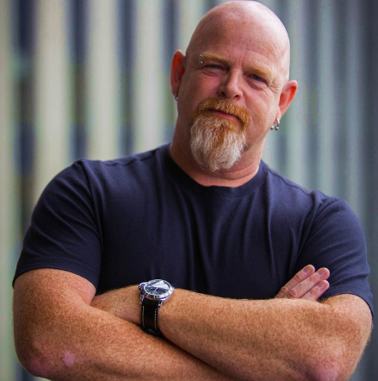
Steve Sims : Make Anything Happen
Go to your networking target with a solution. Give before you ask!
Do not watch the news. They start with “good morning” and then tell you why it’s not
Read books, but make sure every third or fourth one is a fantasy
An entrepreneur alone dies
Together we conquer

Slide 61
Alfred North Whitehead
The art of progress is to preserve order amid change and to preserve change amid order
From “Great Ideas of Western Man”

Slide 62
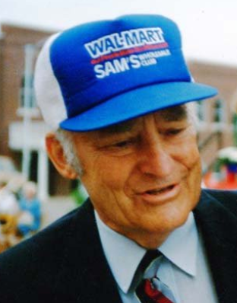
Ten Rules
Sam Walton
Commit to your business
Share your profits with all your associates and treat them as partners
Motivate your partners
Communicate everything you possibly can to your partners
Appreciate everything your associates do for the business
Celebrate your success
Listen to everyone in your company
Exceed your customers expectations
Control your expenses better than your competition
Swim upstrem

